Slide 1

Python Essentials
Notes:
Hello and welcome to Stats 101. Today Sam and I will be walking you through some basic stats principles and answering any questions you may have about these

Slide 2
Agenda
Importing libraries
Importing data
Data types and functions
Dataframes
Dropping nulls/duplicates
Filtering data

Slide 3
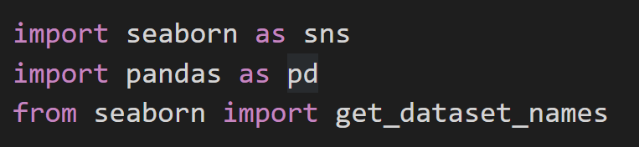
Importing Libraries
Libraries contain functions surrounding a particular theme
Libraries are imported and then notated as an alias, used in the code to call a function
For example, pandas is used for dataframes and data manipulation
The notation ‘from’ is used to pull a specified function from a library without having to refer to the library’s alias

Slide 4
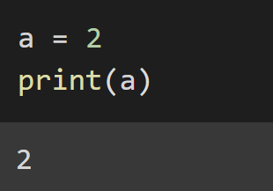
Data Types and Functions
You can assign a value using ‘=‘ and then call that value later in the code
The main data types used in Python are strings, integers, floats, Boolean
There are specific in-built functions which come with Python such as: print(), type(), .islower()
Some functions can only be used on certain datatypes e.g. you will get an error if you try to square root a string

Slide 5
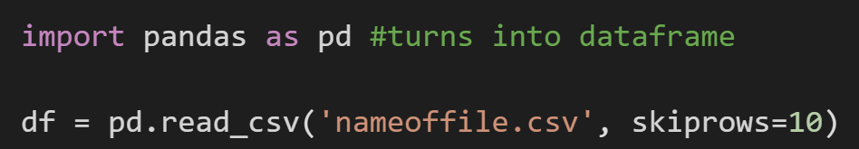
Importing Data
There are different methods and functions to import different data types e.g. .txt, .csv
The pandas library has a function read_csv which imports CSV files into a pandas dataframe
We can now use the pandas functions on the dataframe

Slide 6
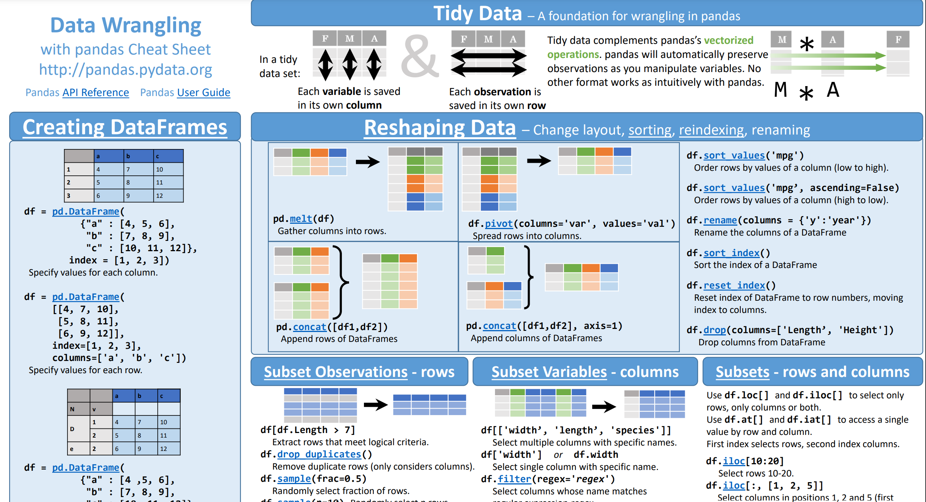
Pandas Functions
The following cheatsheet summarises the functions that come with pandas
For example, dropna() allows you to drop null values from the dataframe
https://pandas.pydata.org/Pandas_Cheat_Sheet.pdf

Slide 7
Filtering Data
Pandas can also be used to filter/subset data to look at a particular attribute or feature
For instance, you can filter data to include only a specific year or people with a height under 6 foot

